Slide 1

Cyber Security Awareness
November 2021

Slide 2
Introduction
Cyber security is how individuals and organisations reduce the risk of cyber attack.
Cyber security's core function is to protect the devices we all use (smartphones, laptops, tablets and computers), and the services we access - both online and at work - from theft or damage.
It's also about preventing unauthorised access to the vast amounts of personal information we store on these devices, and online.
https://www.ncsc.gov.uk/section/about-ncsc/what-is-cyber-security

Slide 3
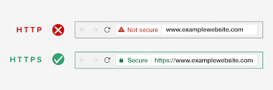
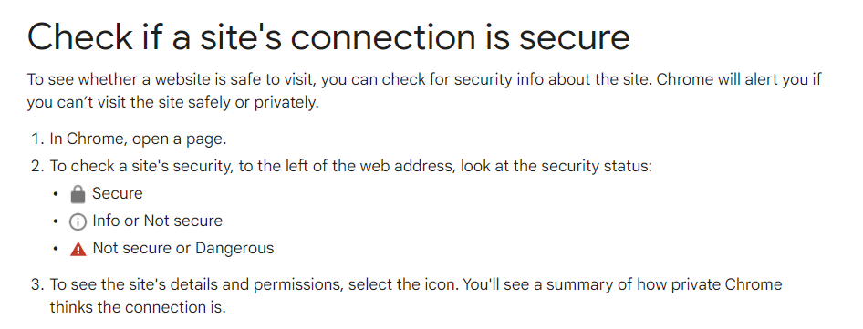
Notes:
Check if a site’s connection is secure image- https://support.google.com/chrome/answer/95617?hl=en-GB
HTTP or HTTPS image- https://prowebmarketing.com/why-have-a-secured-site/

Slide 4

Identity Theft
Identity theft is the crime of obtaining the personal or financial information of another person to use their identity to commit fraud, such as making unauthorized transactions or purchases. Identity theft is committed in many different ways and its victims are typically left with damage to their credit, finances, and reputation.
https://www.investopedia.com/terms/i/identitytheft.asp

Slide 5
How to Avoid Identity Theft Online
Learn to spot spam emails
Strong passwords
Safety from Spyware and Hackers
Online Purchases
https://www.identitytheft.org.uk/how-to-avoid-identity-theft-online/

Slide 6
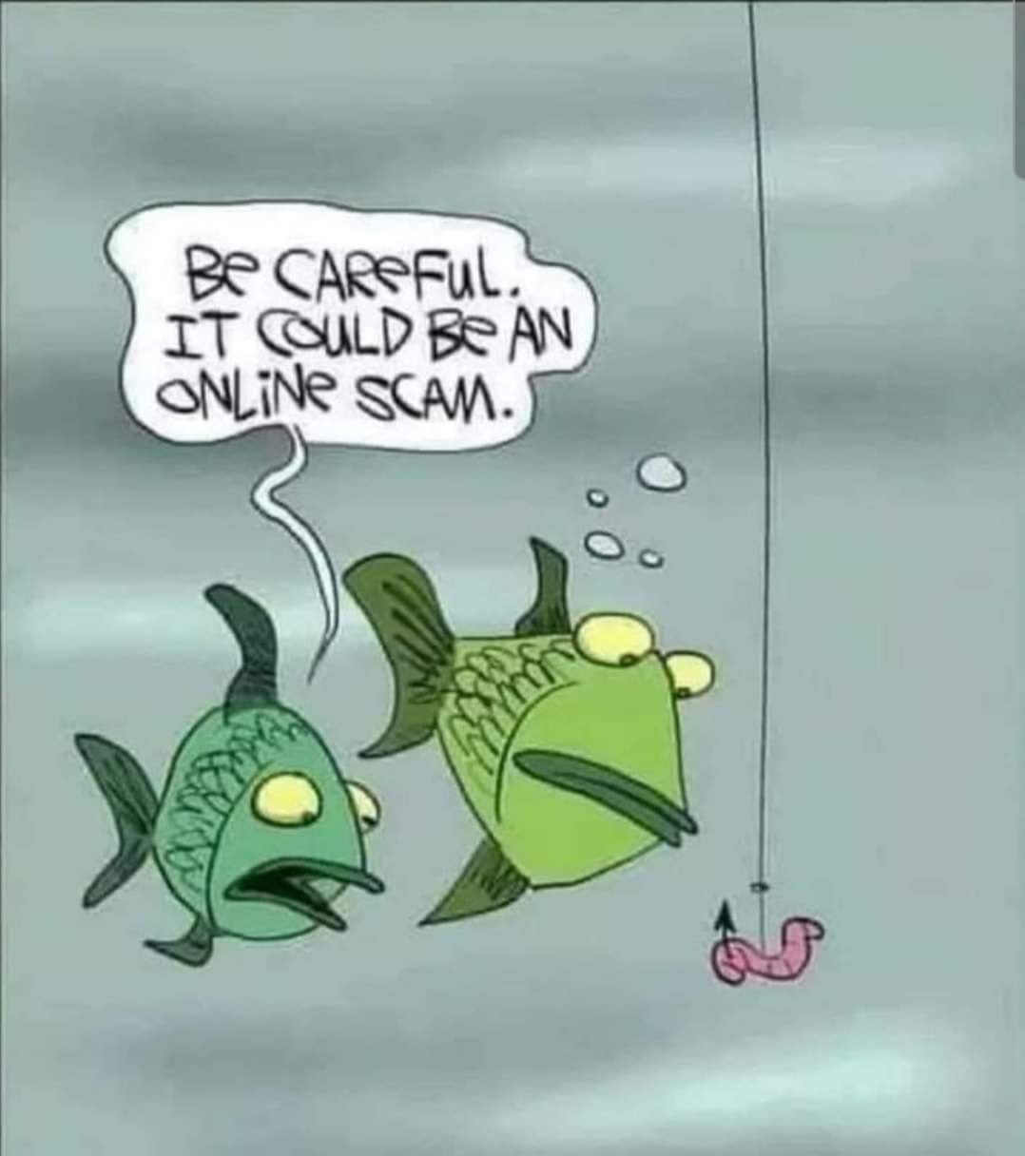
Phishing
Phishing is a type of social engineering attack in which cyber criminals trick victims into handing over sensitive information or installing malware.
More often than not they do this via malicious emails that appear to be from trusted senders, but sometimes use other means…
https://www.itgovernance.co.uk/phishing

Slide 7
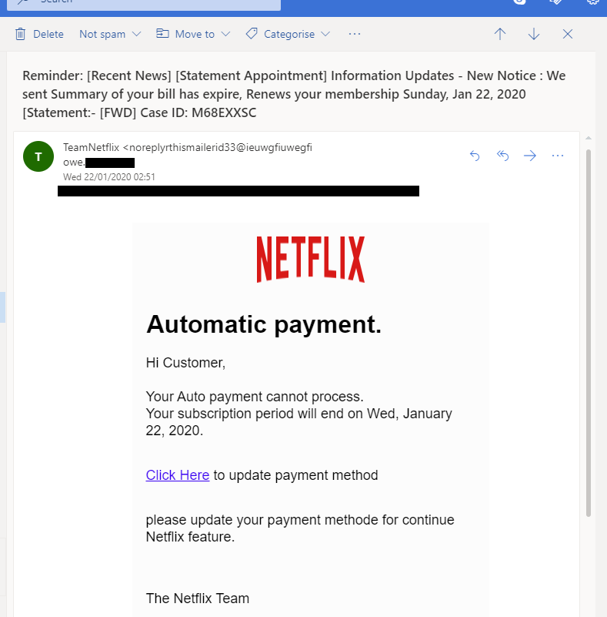
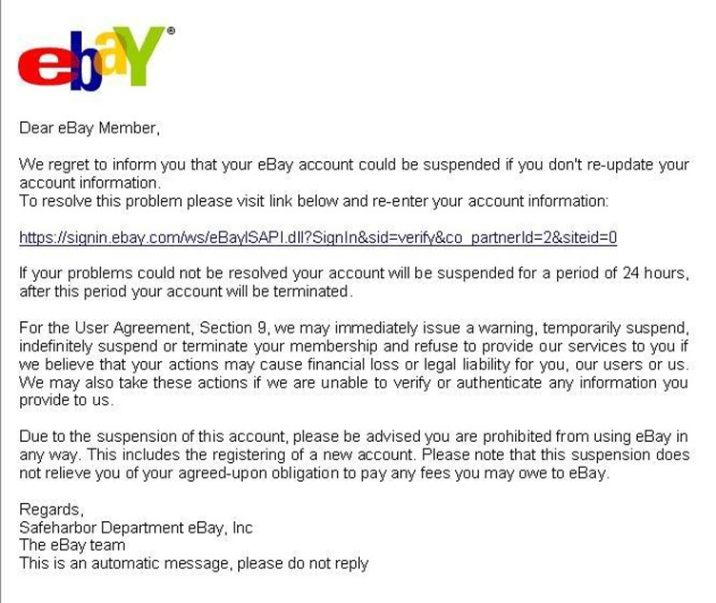
Examples of phishing
Notes:
Netflix picture from https://blog.malwarebytes.com/social-engineering/2020/01/spear-phishing-101-what-you-need-to-know/
eBay picture from https://www.enisa.europa.eu/topics/csirts-in-europe/glossary/phishing-spear-phishing

Slide 8
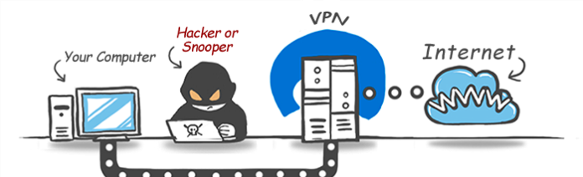
What is a VPN and why should you use one?
A virtual private network (VPN) gives you online privacy and anonymity by creating a private network from a public internet connection. VPNs mask your internet protocol (IP) address so your online actions are virtually untraceable. Most important, VPN services establish secure and encrypted connections to provide greater privacy than even a secured Wi-Fi hotspot.
https://us.norton.com/internetsecurity-privacy-what-is-a-vpn.html
Notes:
Comic from https://anonhq.com/why-vpn/

Slide 9
Small Business Guide NCSC
https://www.ncsc.gov.uk/collection/small-business-guide
Guides on backing up your data, protecting your organisation from malware, keeping mobile devices safe, using passwords to protect your data, avoid phishing attacks
Get your Cyber Action Plan

Slide 10
Other important points
Download antivirus and antimalware, keeping it up to date
Keep personal information professional and limited
Keep your privacy settings on
Practice safe browsing
Make sure your internet connection is secure
Be careful what you download
Choose strong passwords
Make online purchases from secure websites

Slide 11
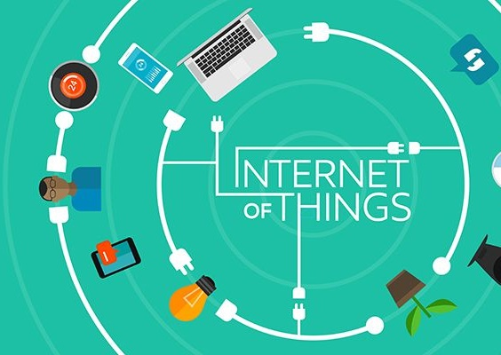
Secure your home network
Create a “guest” network for all of your IoT devices
Manage your IoT devices
Use a VPN
Protect your computers and mobile devices
Monitor threats at the network level
https://www.reuters.com/article/sponsored/ways-to-stay-safe
Notes:
Image from https://www.itproportal.com/features/the-internet-of-things-past-present-and-future/

